Slide 1
ServiceNow Ticket Creation Steps For LIMS Support

Slide 2
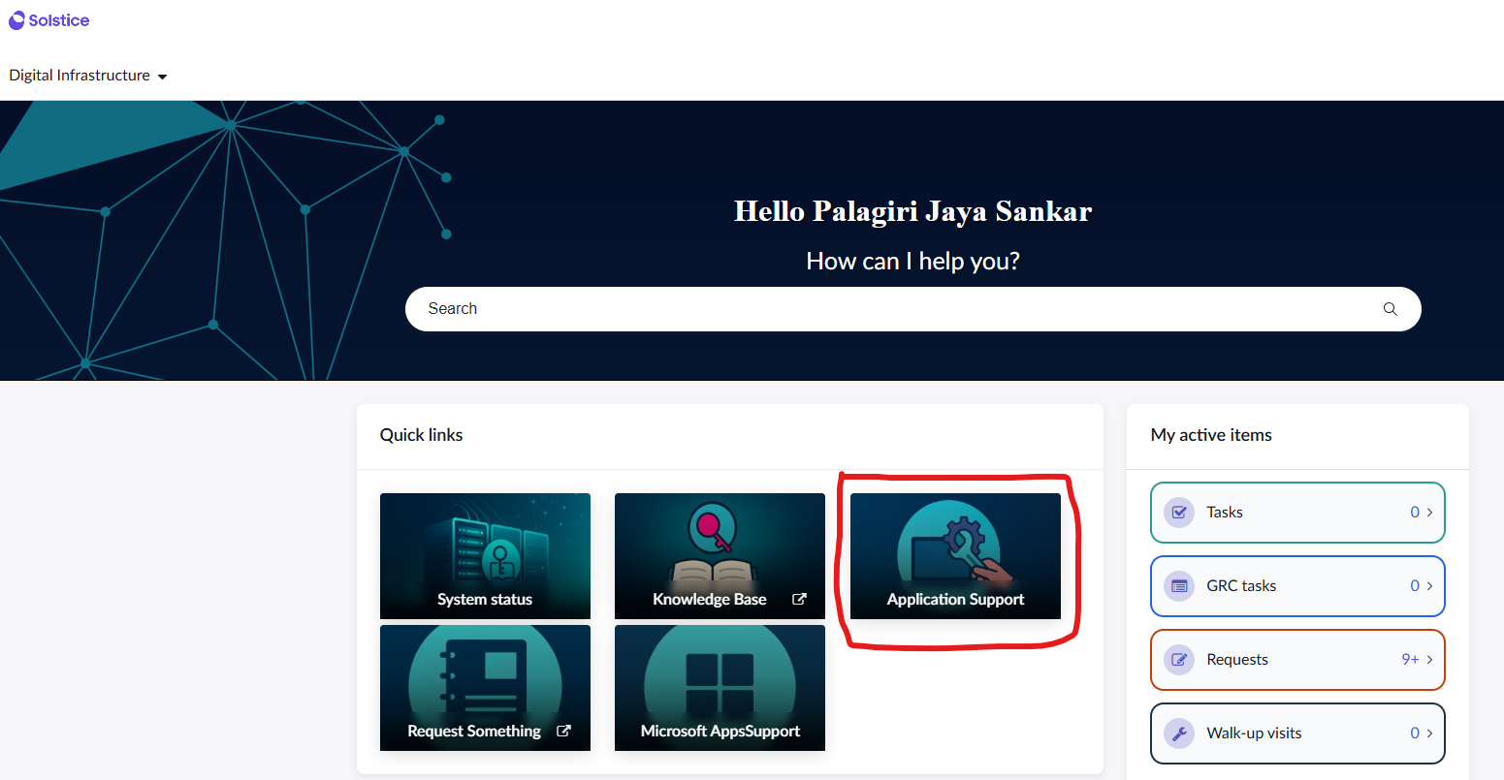
Step 1: Login to ServiceNow here https://solsticeam.service-now.com/esc
Step 2: Click on the “Application Support” Tile on home screen.

Slide 3
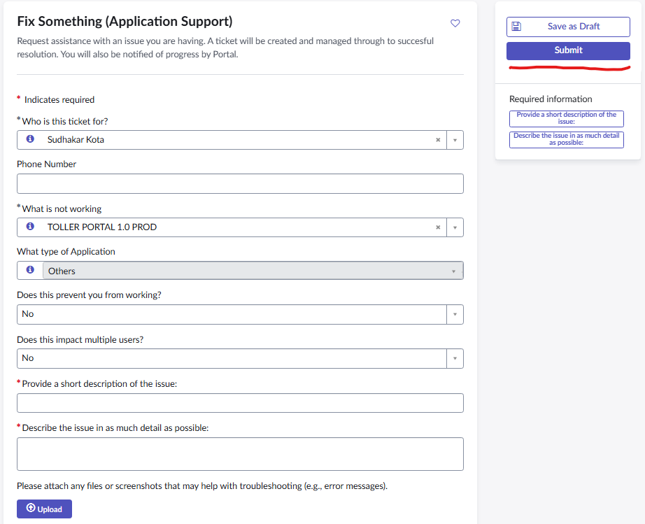
Step 3 : Select the application that you need support in “What is not working?” field as TOLLER PORTAL 1.0 PROD, fill the rest of the fields, describe the issue and Submit the form.

